Slide 1
Introduction to Computer Science (COS 101)
Week I
Chudi Ofoma
cofoma@pau.edu.ng
Dr. Desmond Moru
dmoru@pau.edu.ng

Slide 2
What is Computer Science?
It deals with:
The theory of computation
Algorithms,
Computational problems and
The design of computer systems; hardware, software and applications.
Computer scientists deal mostly with software and software systems; this includes their theory, design, development, and application
Computer Science can be defined as the study of computers and computational systems.

Slide 3


What is Computer Science?
Computer Science addresses both human-made and natural information processes, such as:
Communication
Control
Perception
Learning and
Intelligence, especially in computing systems and machines.

Slide 4
Characteristics of a Computer
SPEED:
ACCURACY:
STORAGE:
DILIGENCE:
VERSATILITY:
POWER OF REMEMBERING:
NO IQ:
NO FEELING:
In general, no human being or any other device can compete to solve complex computation, faster than computer.
It does computation with high precision. In other words, it gives result with high degree of accuracy
Computer has the capacity to store mass volume of data with appropriate format.
Computer never feels bored and it can work for hours and hours without any break and creating error.
Computers are multipurpose. A Computer can perform completely different types of work at the same time.
It stores data for future use.
Computer needs to be instructed to do its job.
Computer does not have emotions, knowledge, experience and feeling.

Slide 5
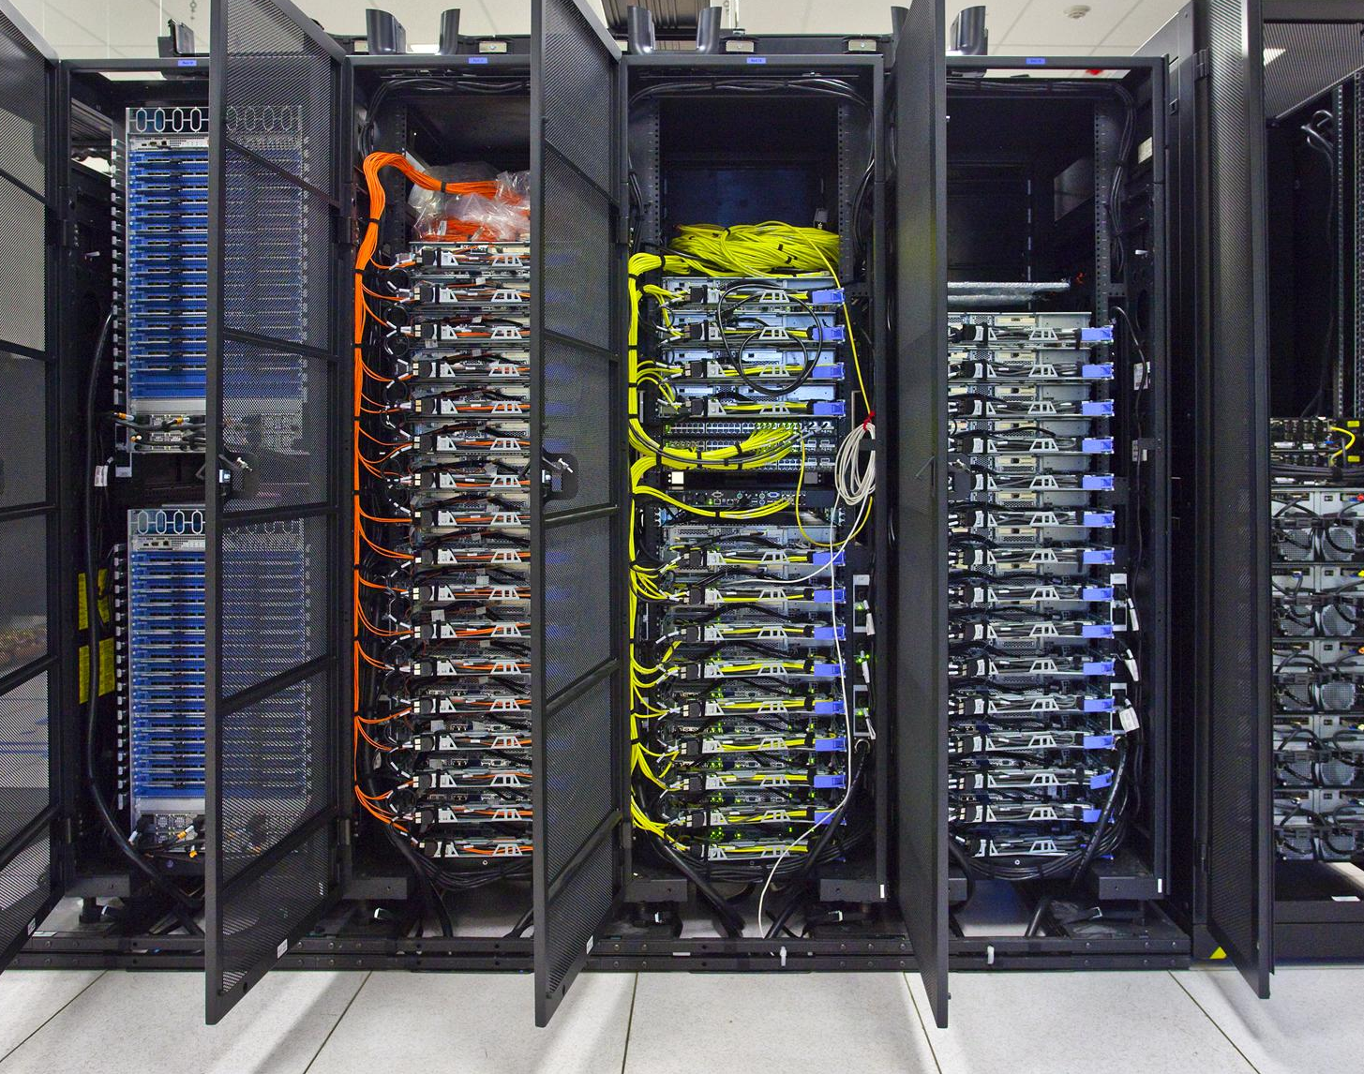
The Universal Machine
A modern computer can be defined as a machine that stores and manipulates information under the control of a changeable program.
It is an electronic device that accepts data, performs computations, and makes logical decision according to instructions that have been given to it; then produces meaningful information in a form that is useful to humans.

Slide 6
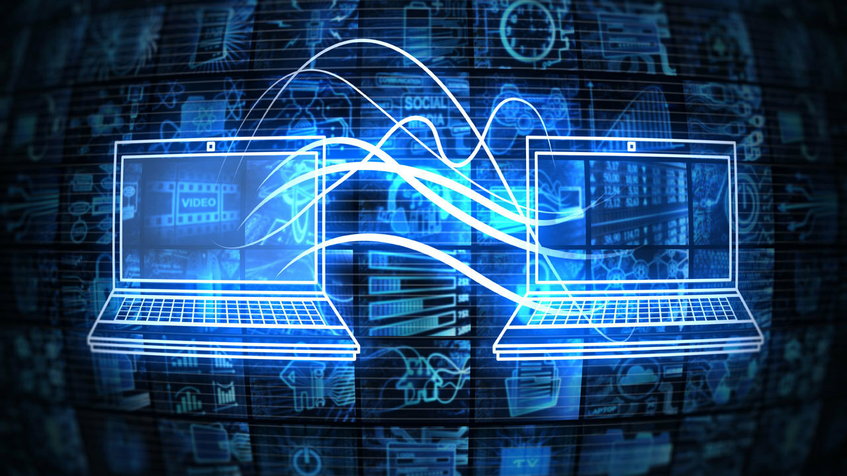
What is a Computer Program?
A computer program is a detailed, step-by-step set of instructions telling a computer exactly what to do.
A computer program is a sequence of instructions written using a Computer Programming Language to perform a specified task by the computer.
An unambiguous, ordered sequence of computational instructions necessary to achieve a solution.
A computer program is a detailed plan or procedure for solving a problem.

Slide 7

What is Computer Science?
Its fields can be divided into theoretical and practical disciplines. E.g.:
Computational complexity theory
Computer graphics and computational geometry
Algorithms
Programming language
Software engineering
Computer architecture and computer engineering
Human–Computer Interaction (HCI)
Artificial intelligence

Slide 8


Historical Perspectives
First generation
1946 – 1959
Second generation
1959 - 1965
Third generation
1965 – 1971
Fourth generation
1971 -1980
Fifth generation
1980 – till date

Slide 9
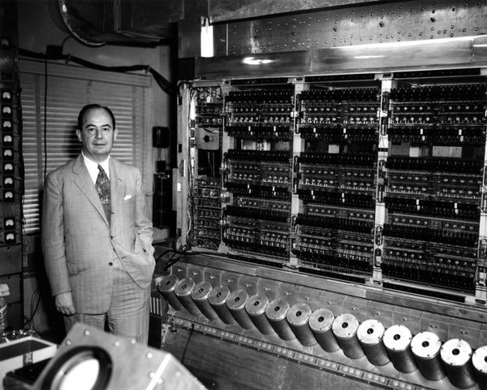
Characteristics of First Generation Computers
Main electronic component
Vacuum tube
Programming language
Machine Language
Main Memory
Magnetic tapes and magnetic drums.
Input/output devices
Paper tape and punched cards.
Speed and size
Very slow and very large in size (often taking up entire room)
Examples of the first generation
IBM 650, IBM 701, ENIAC, UNIVAC1, etc.

Slide 10
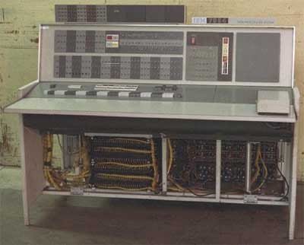
Characteristics of Second Generation Computers
Main electronic component
Transistor
Programming language
Low-level and assembly language
Memory
Magnetic core and magnetic tape/disk.
Input/output devices
Magnetic tape and punched cards.
Power and size
Smaller in size, low power consumption, and generated less heat (in comparison with the first generation computers).
Examples of the second generation
PDP-8, IBM1400 series, IBM 7090 and 7094, UNIVAC 1107, CDC 3600 etc.

Slide 11
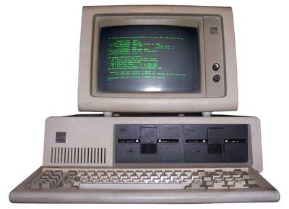
Characteristics of Third Generation Computers
Main electronic component
Integrated circuits (ICs)
Programming language
High-level language
Memory
Large magnetic core, magnetic tape/disk
Input/output devices
Magnetic tape, monitor, keyboard, printer, etc.
Examples of the third generation
IBM 360, IBM 370, PDP-11, NCR 395, B6500, UNIVAC 1108, etc.

Slide 12
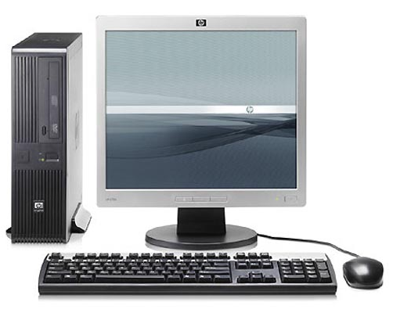
Characteristics of Fourth Generation Computers
Main electronic component
Very large-scale integration (VLSI) and the microprocessor (VLSI has thousands of transistors on a single microchip).
Programming language
Database programming and scripting
Memory
semiconductor memory (such as RAM, ROM, etc.)
Input/output devices
pointing devices, optical scanning, keyboard, monitor, printer, etc.
Examples of the third generation
IBM PC, STAR 1000, APPLE II, Apple Macintosh, Alter 8800, etc.

Slide 13
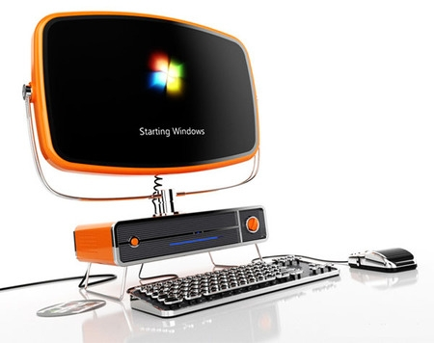
Characteristics of Fifth Generation Computers
Main electronic component
Based on artificial intelligence, uses the Ultra Large-Scale Integration (ULSI) technology and parallel processing method (ULSI has millions of transistors on a single microchip and Parallel processing method use two or more microprocessors to run tasks simultaneously).
Programming language
Understand natural language (human language).
Input/output devices
Trackpad (or touchpad), touchscreen, pen, speech input (recognize voice/speech), light scanner, printer, keyboard, monitor, mouse, etc.
Examples of the third generation
Desktops, laptops, tablets, smartphones, etc.
Size
Portable and small in size.

Slide 14
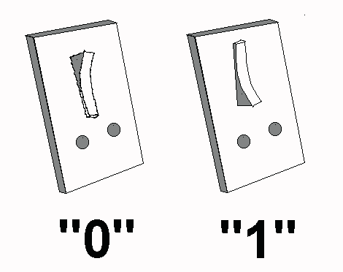
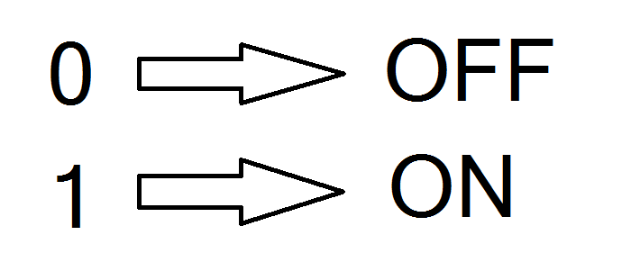
Bits and Data Storage
Binary Numbers are the flow of information in the form of zeros and ones used by digital computers and systems.
BInary digiTS referred to as binary BITS

Slide 15
Boolean Operation
Bit 0 represents the value false and bit 1 represents the value true.
Operations that manipulate true/false values are called Boolean operations, in honor of the mathematician George Boole (1815–1864), who was a pioneer in the field of mathematics called logic.
Three of the basic Boolean operations are AND, OR, and XOR (exclusive or).

Slide 16
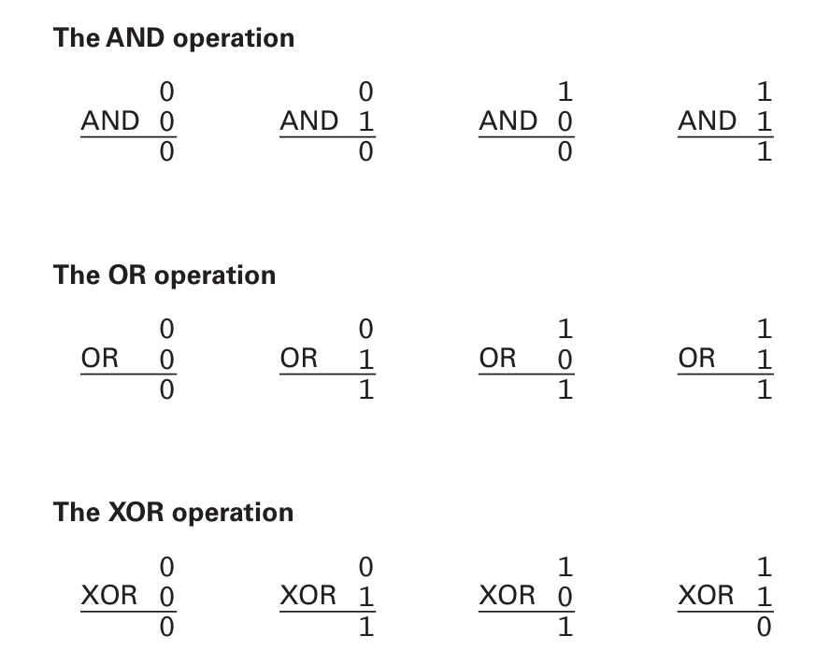
Boolean operations AND, OR, and XOR

Slide 17
Gates and Flip-Flops
A device that produces the output of a Boolean operation when given the operation’s input values is called a gate.
Inside today’s computers, gates are usually implemented as small electronic circuits in which the digits 0 and 1 are represented as voltage levels.
Gates provide the building blocks from which computers are constructed.

Slide 18
Gates and Flip-Flops
A flip-flop is a fundamental unit of computer memory.
It is a circuit that produces an output value of 0 or 1, which remains constant until a pulse (a temporary change to a 1 that returns to 0) from another circuit causes it to shift to the other value.
The flip-flop is only one of many circuits that are basic tools in computer engineering.

Slide 19
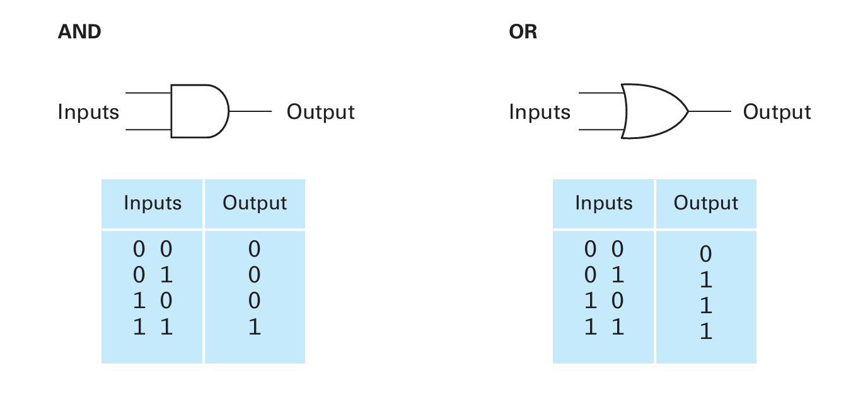
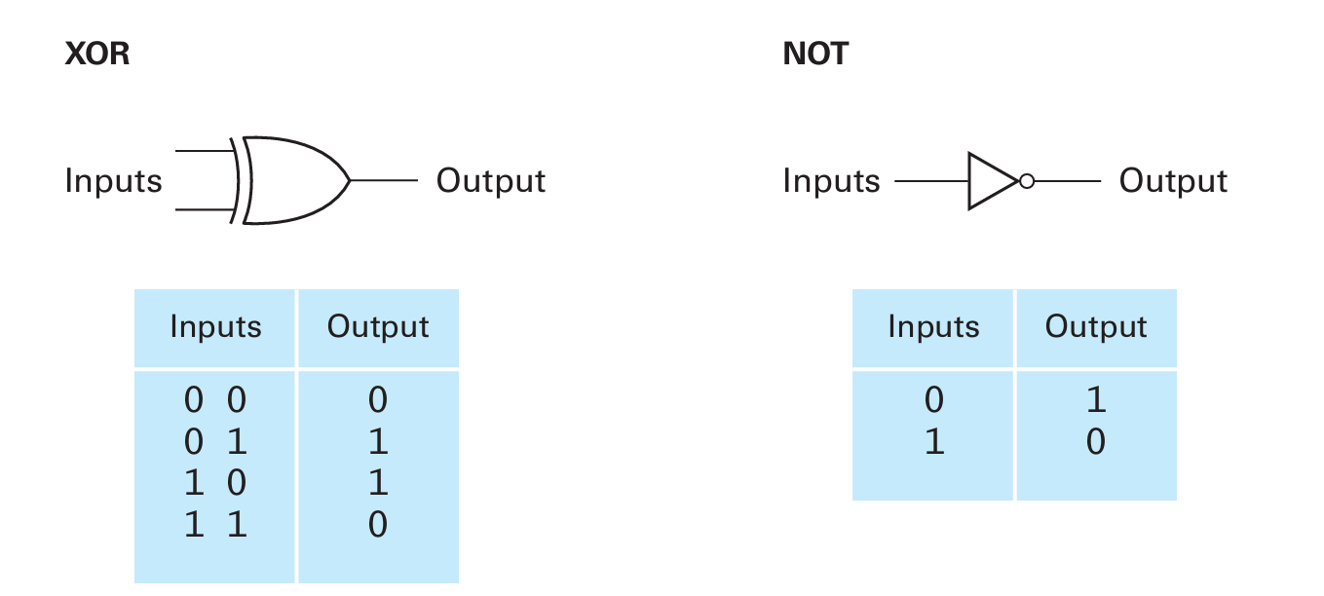
AND, OR, XOR and NOT Gate

Slide 20
Binary to Decimal Conversion
Conversion of binary to decimal (base-2 to base-10) numbers and back is an important concept to understand as the binary numbering system forms the basis for all computer and digital systems.

Slide 21
The Decimal Numbering System
Each number column has values of units, tens, hundreds, thousands, etc.
Mathematically these values are written as 10⁰, 10¹, 10², 10³, etc.
Each position to the left of the decimal point indicates an increased positive power of 10.

Slide 22
The Decimal Numbering System
The value of any decimal number is equal to the sum of its digits multiplied by their respective weights.
For example: N = 6163₁₀
( 6x1000 ) + ( 1x100 ) + ( 6x10 ) + ( 3x1 ) = 6163
OR
( 6x10³ ) + ( 1x10² ) + ( 6x10¹ ) + ( 3x10⁰ ) = 6163

Slide 23
The Binary Numbering System
The most fundamental numbering system in all digital and computer based systems.
Same set of rules as the decimal numbering system.
Unlike the decimal system which uses powers of ten, the binary number system works on powers of two.
Base-2 to Base-10

Slide 24
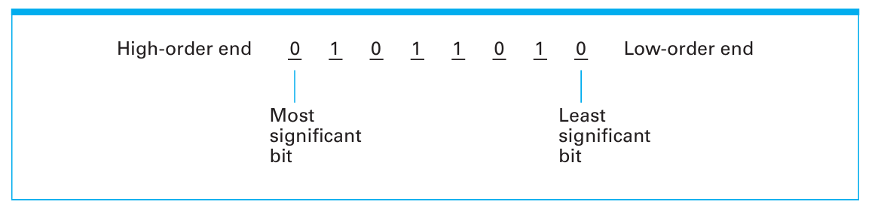
Representation of a Binary Number
Most Significant Bit
Least Significant Bit

Slide 25
Convert a Binary to Decimal number
For example:
Decimal Digit Value | 256 | 128 | 64 | 32 | 16 | 8 | 4 | 2 | 1
Binary Digit Value | 1 | 0 | 1 | 1 | 0 | 0 | 1 | 0 | 1
By adding together all the decimal number values from right to left at the positions that are represented by a “1” gives us:
(256) + (64) + (32) + (4) + (1) = 357₁₀

Slide 26
Binary Number Names & Prefixes
Number of Binary Digits (bits) | Common Name
1 | Bit
4 | Nibble
8 | Byte
16 | Word
32 | Double Word
64 | Quad Word

Slide 27
Number of bytes
1000 bytes = 1 kilobyte (KB) (same as 1000¹ bytes)
1000 KB = 1 megabyte (MB) (same as 1000² bytes)
1000 MB = 1 gigabyte (GB) (same as 1000³ bytes)
1000 GB = 1 terabyte (TB) (same as 1000⁴ bytes)
1000 TB = 1 petabyte (PB) (same as 1000⁵ bytes)
1000 PB = 1 exabyte (EB) (same as 1000⁶ bytes)
1000 EB = 1 zettabyte (ZB) (same as 1000⁷ bytes)
1000 ZB = 1 yottabyte (YB) (same as 1000⁸ bytes) I will not demand for more than this level
1000 YB = 1 xenottabyte (XB)
1000 XB = 1 shilentnobyte (SB)
1000 SB = 1 domegemegrottebyte (DB)

Slide 28
Hexadecimal Numbers
Hexadecimal Numbers group binary numbers into sets of four allowing for the conversion of 16 different binary digits.
The “Hex” numbering system uses the Base of 16 system.
The one main disadvantage of binary numbers is that the binary string equivalent of a large decimal base-10 number can be quite long.

Slide 29
Hexadecimal Numbers
Decimal number | 4-bit Binary Number | Hexadecimal Number
0 | 0000 | 0
1 | 0001 | 1
2 | 0010 | 2
3 | 0011 | 3
4 | 0100 | 4
5 | 0101 | 5
6 | 0110 | 6
7 | 0111 | 7
8 | 1000 | 8
9 | 1001 | 9
10 | 1010 | A
11 | 1011 | B
12 | 1100 | C
13 | 1101 | D
14 | 1110 | E
15 | 1111 | F

Slide 30
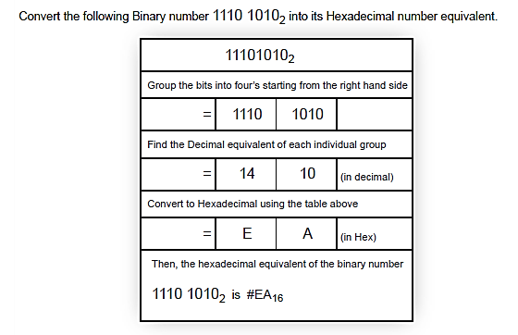
Hexadecimal Numbers Example

Slide 31
Coding Systems for Text-Based Data
While numeric data is represented by the binary numbering system, text-based data is represented by binary coding systems specifically developed for text-based data — namely, ASCII, EBCDIC, and Unicode.
These codes are used to represent all characters that can appear in text data—such as numbers, letters, and special characters and symbols like the dollar sign, comma, percent symbol, and mathematical symbols.

Slide 32
ASCII and EBCDIC
ASCII (American Standard Code for Information Interchange) is the coding system traditionally used with personal computers.
EBCDIC(Extended Binary-Coded Decimal Interchange Code) was developed by IBM, primarily for use with mainframes.

Slide 33
Unicode
Unlike ASCII and EBCDIC, which are limited to only the Latin alphabet used with the English language, Unicode is a universal international coding standard designed to represent text-based data written in any ancient or modern language, including those with different alphabets, such as Chinese, Greek, Hebrew, Amharic, Tibetan, and Russian.

